Slide 1


Slide 2


=sharing
Training Videos on Company’s Incident
ONBOARD
FUEL MANAGEMENT
PORT HEADLAND INCIDENT
https://synergycloud.sharepoint.com/:v:/s/CMS/EW0bPsACoQZJjrc6vzyY2dkBAodcoasAolBqJw5xOW6ViA?e=56wlte
https://drive.google.com/file/d/1oQJEdeUqdNrMzr1ntWCNo4Ga_1-ps2zZ/view?usp

Slide 3

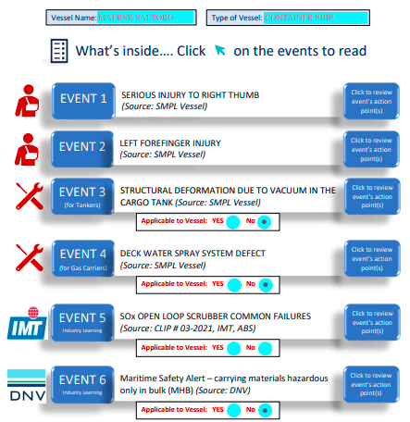
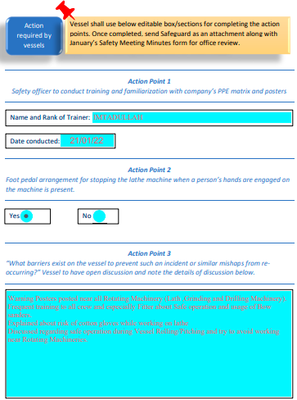

An editable pdf document.
Ahoy, mobile, tablet friendly.
Curbs additional documentation from vessel to show compliance.
Channelizes information sharing with all vessels under one umbrella and in a uniform manner. Thus, assisting vessel to plan and implement the learning in a more productive way.
Smoothens the office review process of action points completed by the vessel.
Platform to share industry learnings.
Let us use “Safeguard” to ensure that the measures taken on board are robust in preventing similar incidents from reoccurring.

Slide 4

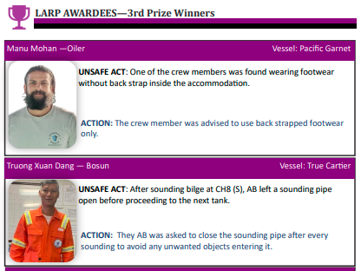
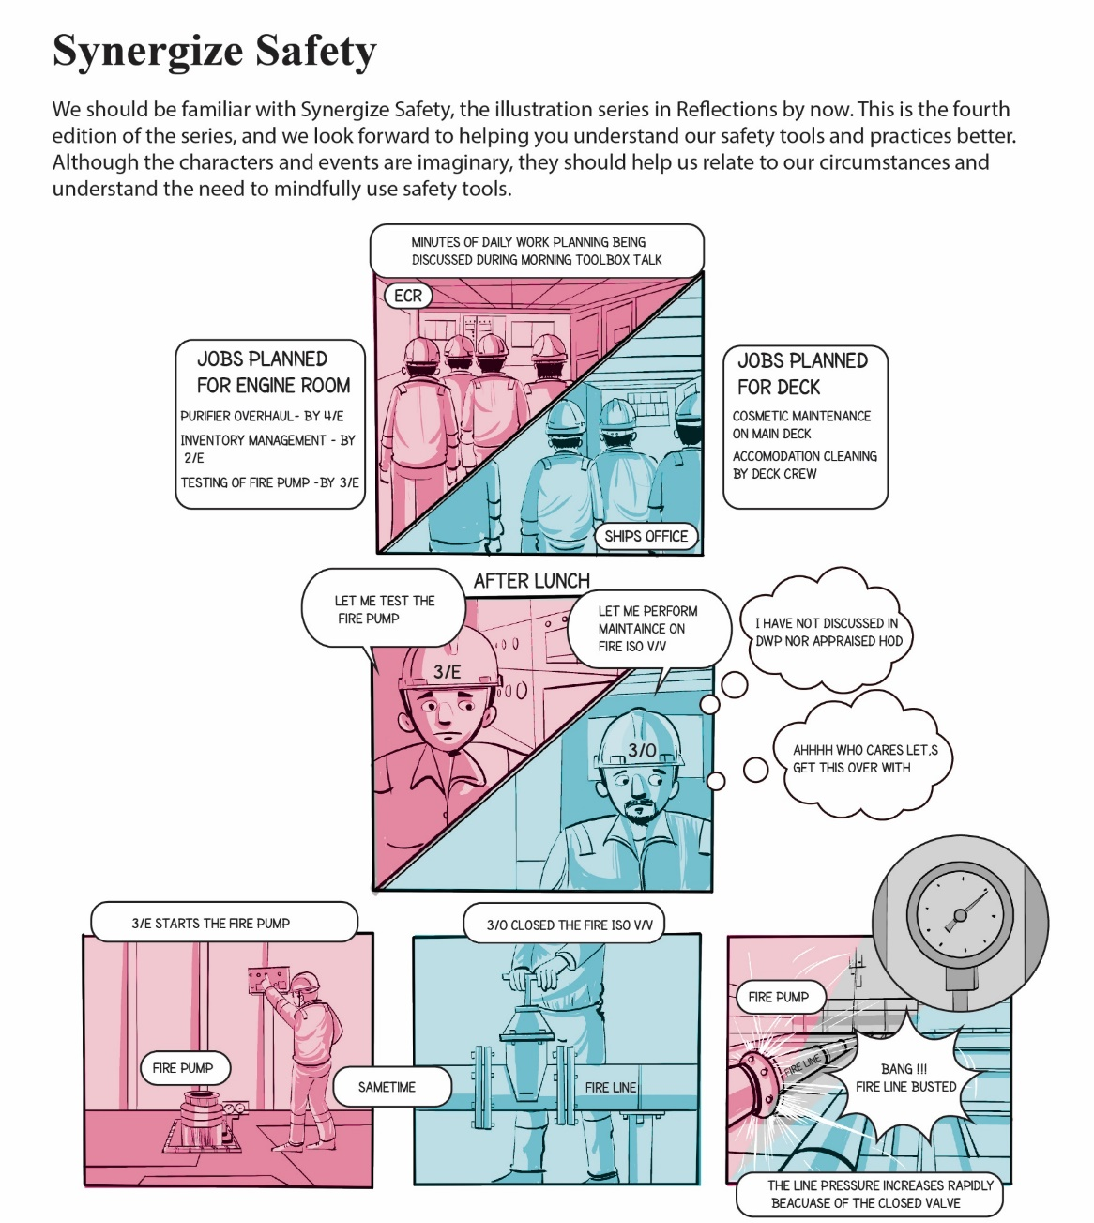

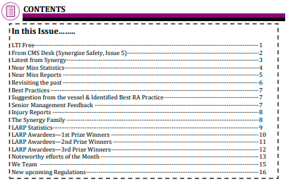



Reflections – Monthly Safety Magazine

